Slide 1
EN 410 Energy Management
Gurubalan Annadurai
guru.a@iitb.ac.in

Slide 2
Problem 2 (Indirect method) – Furnace Oil Burner
Boiler data
Fuel firing: 2650 kg/hr
Surface temperature of boiler: 80 °C
Surface area of boiler: 90 m²
Fuel analysis (in %)
Carbon: 84
Moisture:0.5
Hydrogen: 12
Nitrogen: 0.5
Sulphur:1.5
Oxygen: 1.5
GCV of Coal: 10000 kcal/kg
Flue gas analysis
V%CO₂ in flue gas: 10.8
V%O₂ in flue gas: 7.4
Flue gas temperature: 190 °C
Ambient data
Ambient temperature: 30 °C
Humidity: 0.025 kg / kg dry air
Wind velocity: 3.8 m/s

Slide 3
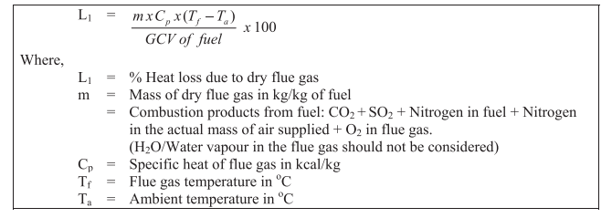
Flue Gas Heat Loss
m = Total mass of flue gas – Mass of water vapor
= Mass of air flow rate + Mass of fuel rate – (9*Hydrogen content in fuel )- Moisture content in fuel (and air)
Cp = 0.24 kcal/kg

Slide 4
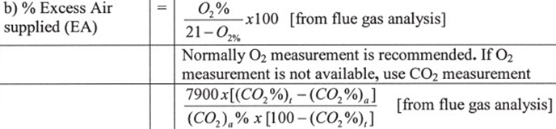
Mass flow rate of air
C + O₂ → CO₂ + 8084 kcal/kg of carbon burnt
H₂ +1/2 O₂ → H₂O + 28922 kcal/kg of H₂
S + O₂ → SO₂ + 2224 kcal/kg of S
Theoretical air
Excess air
Actual mass of supplied air

Slide 5
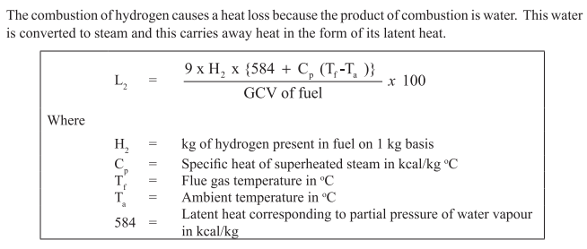
Heat Loss due to the formation of water
Cp = 0.45 kcal/kg

Slide 6
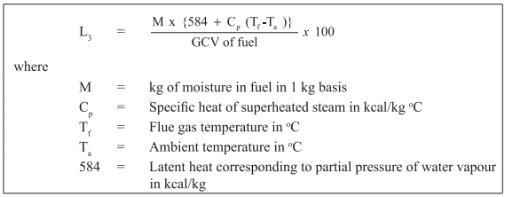
Heat Loss due to Moisture in Fuel
Cp = 0.45 kcal/kg

Slide 7
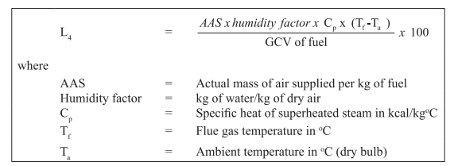
Heat Loss due to Moisture in Air
Cp = 0.45 kcal/kg

Slide 8
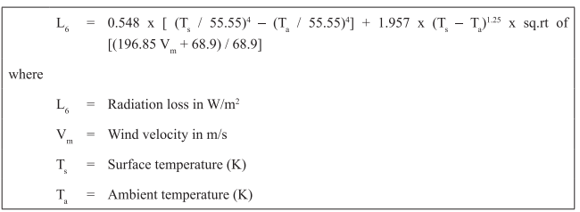
Surface heat loss
Difficult to estimate
Assumed based on type and size of boiler
Industrial fire tube boiler – 1.5 to 2.5 %
Industrial water tube boiler – 2 to 3 %
Power station boiler – 0.4 to 1%
W = 0.86 kcal/hr

Slide 9
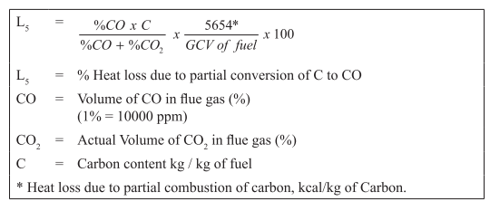
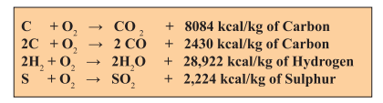
Heat Loss due to Incomplete Combustion

Slide 10
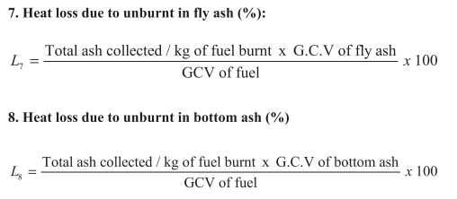
Heat Loss due to unburnt fuel

Slide 11
Boiler efficiency
Indirect efficiency = 100 – Losses

Slide 12
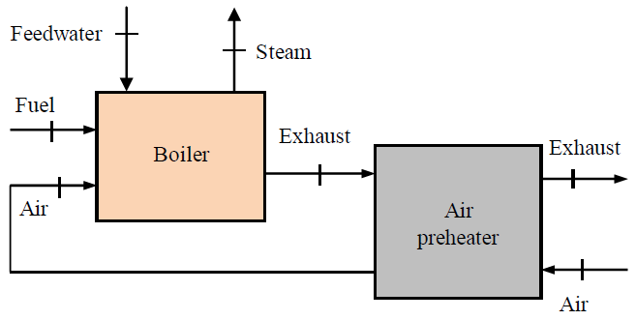
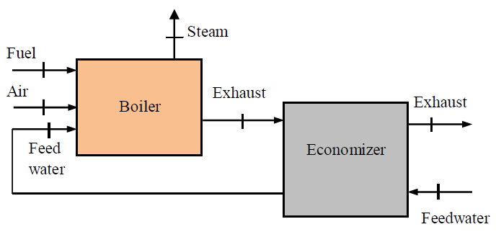
Energy Conservation - Air preheater and economizer
Air preheater: A heat exchanger that transfers heat from the exhaust gases to the inlet air.
Economizer: A heat exchanger that transfer heat from exhaust gases to feedwater.
Economizers are preferred over air preheaters for boilers of less than about 25 TPH capacity.

Slide 13
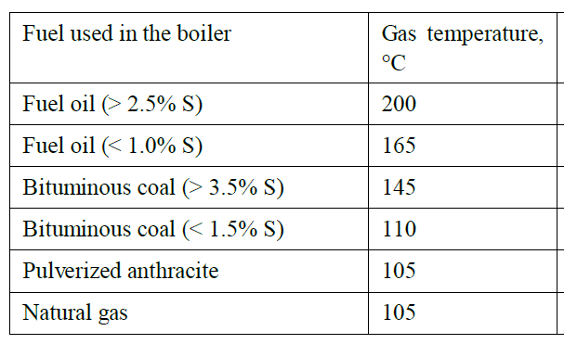
Minimum Exhaust Temperature
A main method of improving boiler efficiency is to recover heat of stack gases.
However, temperature of stack gases should not be lowered below certain limits to avoid corrosion problems.
For boilers generating steam, the exhaust gas temperature should not be lower than the temperature of steam.
For effective heat transfer and reasonable boiler size, the exhaust temperature should be about 80°C greater than the steam temperature.
It is more economical to recover heat of exhaust gases by using air preheaters and economizers rather than adding more heat transfer surfaces in the boiler to decrease exhaust temperature.

Slide 14
Energy Conservation - optımizing air-fuel ratio
One of the easiest and most effective methods to increase the efficiency of a boiler is to optimize air-fuel ratio.
Excess air: Most boilers operating at high temperatures use 10 to 20% excess air.
The recommended value is often about 10% excess air for natural gas boilers and 20% excess air for boilers using liquid or solid fuels.
Any air-fuel ratio below and above the optimum value would decrease the boiler efficiency.
Deficiency of air: If the air-fuel ratio is less than the stoichiometric (theoretical), some fuel will leave the boiler unburned as there is not sufficient air to burn all the fuel.
Liquid and solid fuels require more excess air than gaseous fuels.

Slide 15
Using multiple boilers
In some industrial facilities, two or more boilers are installed for process steam or hot water requirements.
Usually one or more boilers operate simultaneously to meet the base demand, and an additional one is put in operation when there is extra demand.
This scheme of using multiple boilers is usually preferred over using a large boiler with a sufficient rating to meet the entire demand.
This is because the large boiler operates at part load (and low efficiency) most of the time.
Boilers are generally designed to have maximum efficiency at the rated full power. At part load, the boiler efficiency decreases.
One major reason for this is that heat losses remain essentially the same when the load is decreased.

Slide 16
Other Opportunities
Condensate recovery : The maximum possible amount of condensate water should be returned to boiler to reduce heat transfer requirement for a given hot water or steam output.
Blowdown heat recovery
Sufficient insulation
Energy efficient fans, blowers and pumps
Soot blowers: They can be used to remove boiler tube deposits that hurt heat transfer.
Fuel additives: Combustion catalysts, Soot eliminators, Ash modifiers
Appropriate boiler water treatment

Slide 17
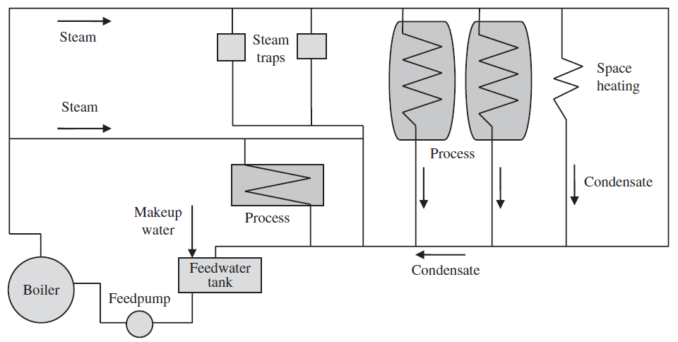
Steam Distribution Network
Optimum pressure and diameter
Superheated ~ 50-70 m/s
Saturated ~ 30-40 m/s
Wet ~ 20-30 m/s
Falling slope > 125 mm for every 30 m in the direction of steam flow
Drain points @ every 30-45 m, elevation changes, equal tee connections
Branch lines from top

Slide 18
Steam traps
Steam traps are an essential part of a steam distribution network.
The functions of steam traps are:
To discharge condensate as soon as it is formed (which also prevents water hammer) without steam loss
To be capable of discharging air and other non-condensable gases

Slide 19
Steam traps
Mechanical steam trap is operated by sensing the density difference between the steam and condensate. It only allows high density condensate to pass into trap. Two types in this category are ball float traps and inverted bucket traps.
Thermostatic steam trap is operated by changes in water temperature. Steam is condensed at the saturation temperature corresponding to its pressure. Thermostatic steam trap senses this lower temperature subcooled liquid and responds by passing the condensate.
Thermodynamic steam trap is operated by changes in fluid dynamics. The formation of flash steam from condensate is used in its operation. Disc, impulse, and labyrinth steam traps are included in this group.

Slide 20
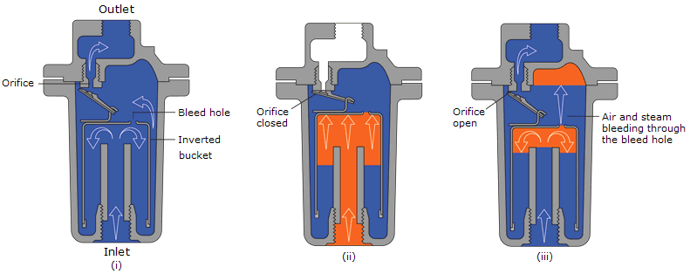
Inverted bucket trap
https://www.youtube.com/watch?v=VA1csDl1Mfw
https://www.youtube.com/watch?v=eWS6pN8-zDs

Slide 21
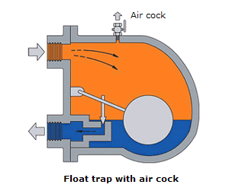
Float trap
https://www.youtube.com/watch?v=HP2epe-8FtA
https://www.youtube.com/watch?v=FV9pmX86j8o

Slide 22
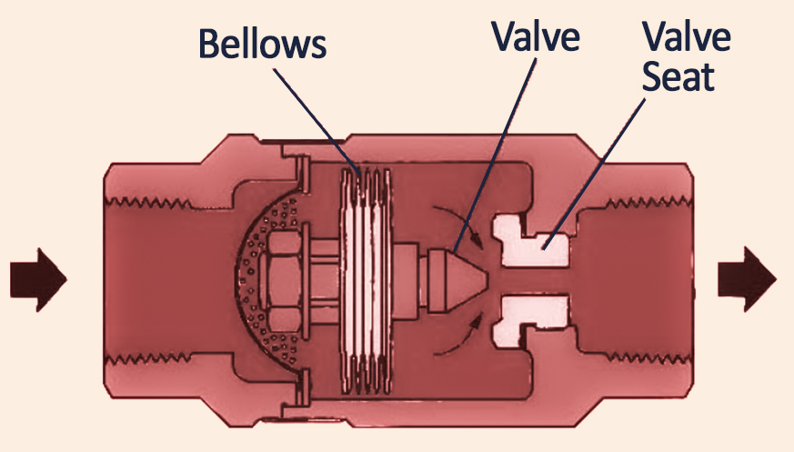
Thermostatic trap
https://www.youtube.com/watch?v=fbJbg2kKx4Q

Slide 23
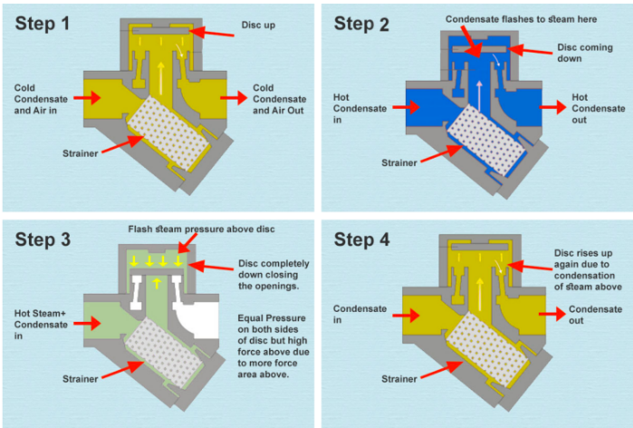
Thermodynamic trap
https://www.youtube.com/watch?v=dd04w_JLIuQ

